Slide 1

NNSA Minority Serving Institutions
Annual Report
Lighting the Way 2010
NNSA Cybersecurity Interns
        Timothy Kentopp, GSLC, MCSE
        Chief Technology Officer
        Principle Investigator
Lighting the Way – NNSA Cybersecurity Interns November 9 – 10, 2010

Slide 2
We Will Review…
Select facets of Voorhees MSI work, specifically:
  Essentials. Core focus & participants.
  History. Qualitative, quantitative.
  Challenges. Useful adjustments, but others?
  Future. What interests emerge?
Lighting the Way – NNSA Cybersecurity Interns November 9 – 10, 2010

Slide 3
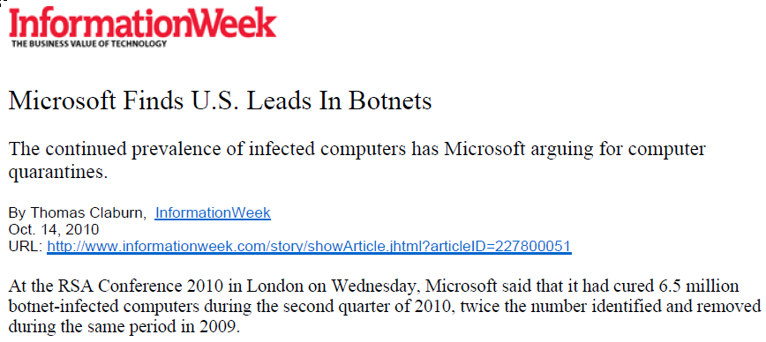
Why Cybersecurity?
Anti-Virus Dead?
Lighting the Way – NNSA Cybersecurity Interns November 9 – 10, 2010

Slide 4
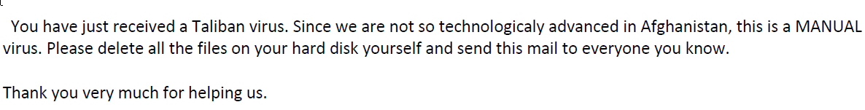
On A Lighter Note…
The following email failed to afflict some users on our campus…
Lighting the Way – NNSA Cybersecurity Interns November 9 – 10, 2010

Slide 5
The Federal Interest
Confidentiality, Integrity and Availability essential to effective governance.
  Regulatory.
    FISMA, DoD 8570, HIPAA, SOX, GLBA, PCI
  Defense.
    Cyberwarfare, cyberterrorism, cybercrime
  Citizens.
    Identity theft, global competition, virtual lives
Lighting the Way – NNSA Cybersecurity Interns November 9 – 10, 2010

Slide 6
How It Works…
Graduates have: 1. A formal degree; 2. First-hand workplace experience; 3. World-class industry-recognized certifications.
  Help Desk. Support of live campus systems.
  Train/Certs. Five courses validate preparation for three certifications (e.g. CISSP)
  Internships. Summer assignments @ NNSA.
Lighting the Way – NNSA Cybersecurity Interns November 9 – 10, 2010

Slide 7
Which Students/Majors?
Those that work directly with technology.
  Comp Science. SW, HW, Network
  Math. Algorythms are the grist in the mills of cryptography
  BA/Finance. eCommerce
  Previously Criminal Justice, Mass Com (Can you think of others?)
Lighting the Way – NNSA Cybersecurity Interns November 9 – 10, 2010

Slide 8
Types of Technology Interns Use
  Encrypted wireless, Layer 3 switched networks, IP telecom/conferencing
  Firewalls, SPAM/content filters, IDS/IPS
  Network Access Control, Endpoint Security
  Virtual machines, digital forensics, Web 2.0
  DMZs, honey pots, disaster recovery tools
  Software design, prototypes
Lighting the Way – NNSA Cybersecurity Interns November 9 – 10, 2010

Slide 9
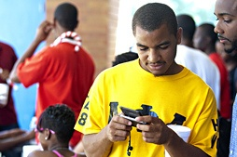
Types of Technology Interns Use
  Most Important – They use their own!
  The Motorola Droid – Tyquan Parker
Lighting the Way – NNSA Cybersecurity Interns November 9 – 10, 2010

Slide 10
Summer Internships …
  Labs – LLNL, SNL, LANL, SRS, IARC.
  Administrative – NNSA HQ, Service Center
By The Numbers…
  1st Year – Seven
  2nd Year – Thirteen
  3rd Year – Twenty-one
  4th, 5th Year – Fifteen
Lighting the Way – NNSA Cybersecurity Interns November 9 – 10, 2010

Slide 11
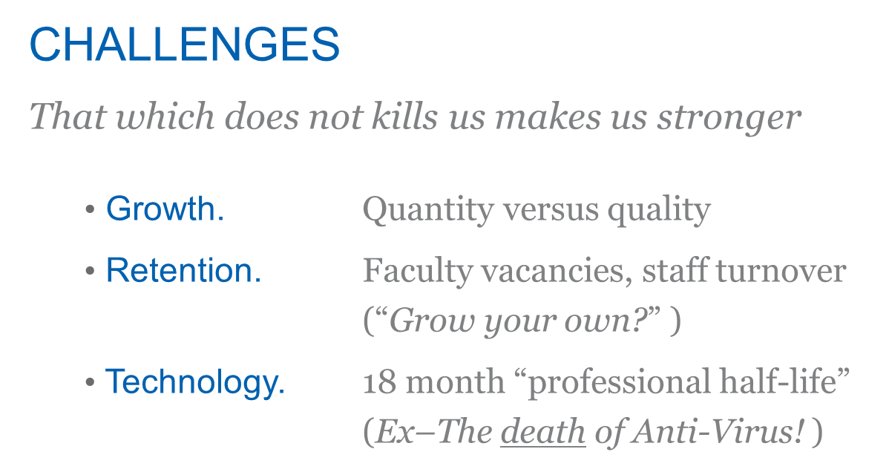
Lighting the Way – NNSA Cybersecurity Interns November 9 – 10, 2010

Slide 12
Future Interests – Topics, Players
So much to do, so little time...
  Application Whitelisting Death to botnets! (Bit9, MS)
  Mobile, Related Dev iPad, Droid applications
  Social, Gaming Nets Twitter, “This game uses ports?”
  The “Cloud”, Virtual Serious hype, successful trials?
  Grow the Program MSI, Others – Claflin first!
(Final slide, please…)
Lighting the Way – NNSA Cybersecurity Interns November 9 – 10, 2010

Slide 13
We Gratefully Acknowledge…
The National Nuclear
Security Administration
        Diversity & Outreach
        Office of the CIO
        Site Staff & Contractors
Lighting the Way – NNSA Cybersecurity Interns November 9 – 10, 2010

